Slide 1
Recommendation of Neighbourhood for New Business in Toronto City

Slide 2
Overview
An Indian business firm want to expand their business.
They want to open Indian Fast food and snack Centre and Fitness Club which will have most of the indoor activities in Toronto city, Canada.

Slide 3
Business Problem
An Indian firm need recommendation for opening their business.
They have an Idea of opening
Indian fast food and snacks center
Fitness club – Gym, Swimming pool,
Table Tennis, Badminton, Chess etc. Indoor games.
Where should they open their new kind business.
In which part of Toronto city would be great to make more customers and profit ?

Slide 4
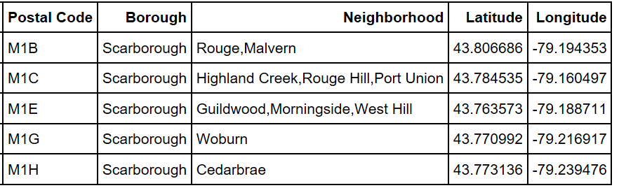
Data Description
Data sources :
List of Borough’s and Neighbourhood’s that belongs to each Borough
Longitude and latitude for each Neighbourhood
Foursquare API – which will provide venue details around each Neighbourhood.

Slide 5
Data Description Cntd..
FourSquare API :
Foursquare is a technology company that built a massive dataset of location data. What is interesting about Foursquare is that they were very smart about building their dataset.
Make the call to FourSquare API :
url ='https://api.foursquare.com/v2/venues/explore?&client_id={}&client_secret={}&v={}&
ll={},{}&radius={}&limit={}'
CLIENT_ID = # your Foursquare ID
CLIENT_SECRET = # your Foursquare Secret
VERSION = # Foursquare API version
LIMIT = #Foursquare calls

Slide 6
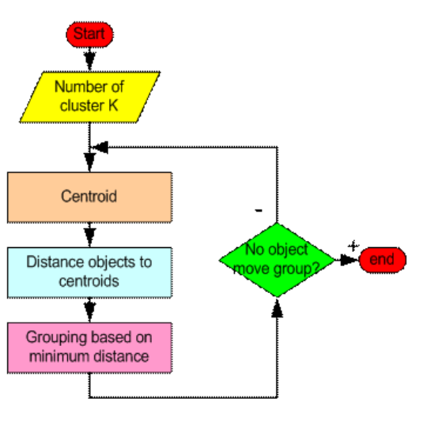
Methodology
The K-means clustering algorithm is used to find groups which have not been explicitly labelled in the data.
This algorithm is guaranteed to converge to a result however the result may be a local optimum.
Once the algorithm has been run and the groups are defined, any new data can be easily assigned to the correct group.

Slide 7
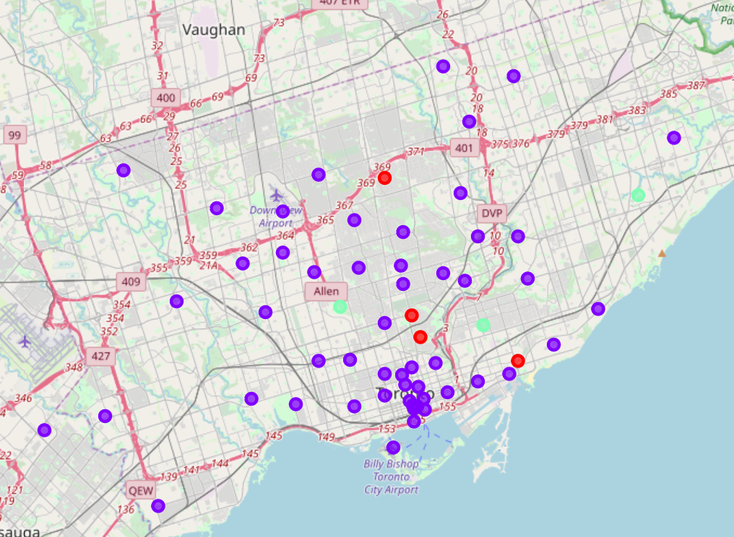
Methodology Cntd…
After applying Kmeans algorithm on collected dataset we have got the three major clusters plotted on Toronto map as below.
Cluster 1 (Blue) : There are many restaurants, Cafe's and eateries in this region
Cluster 2 (Red) : This is famous for Women Health & Beauty Service and Women's Store
Cluster 3 (Green): There are parks and Dessert Shop and Farmer's Market

Slide 8
Results
We have got the 3 major clusters and based on these three clusters we have identified below points:
Result for Indian Fats food and snack centre: We have found out Indian restaurant which are just selling Indian meals and not the Snacks and fast food.
Result for Fitness Club: We have found out the places which are full of activities and happening area and where most of Gym and fitness centres are not present (By Excluding Neighbourhoods where Gym and fitness centres are present). Also found the places where outdoor activities or park is nearby as these areas or spot would be great for Indoor sports too.

Slide 9
Conclusion
Recommended location for Indian Fast food and snacks canter:
In Cabbagetown, St. James Town, Thorncliffe Park Neighbourhood there are 2 Indian Restaurant.Our Contractor wants to open new restaurant for Indian Snacks and Fast Food.
So If he open here he can lure the Customer which are visiting Indian restaurants present at these locations and as these restaurants are not offering/selling any Indian fast food and snacks(They are just selling Indian Meals). So opening new Indian Fast food and snacks center he can make the good start by attracting Indian Customers already vising here. Hence Cabbagetown, St. James Town, Thorncliffe Park Neighbourhood is recommended location for our Contractor.
Recommended location for Fitness Club:
In The Beaches ,East Toronto seems to be the best place for Fitness Club. This area is having park and outdoor activities but not the Indoor activities. Also all the activities are not at one place e.g Dance studio is seperate , plaground is at different spot,park is somewhere else so user or customer has to visit different places if he has to do all the sport for fitness activities.
So If he open the Fitness Club which will have all the Indoor activities like Gym, Zumba dance , Swimming Pool, Table tennis, badminton and tennis Court etc will make good business here.

